Slide 1
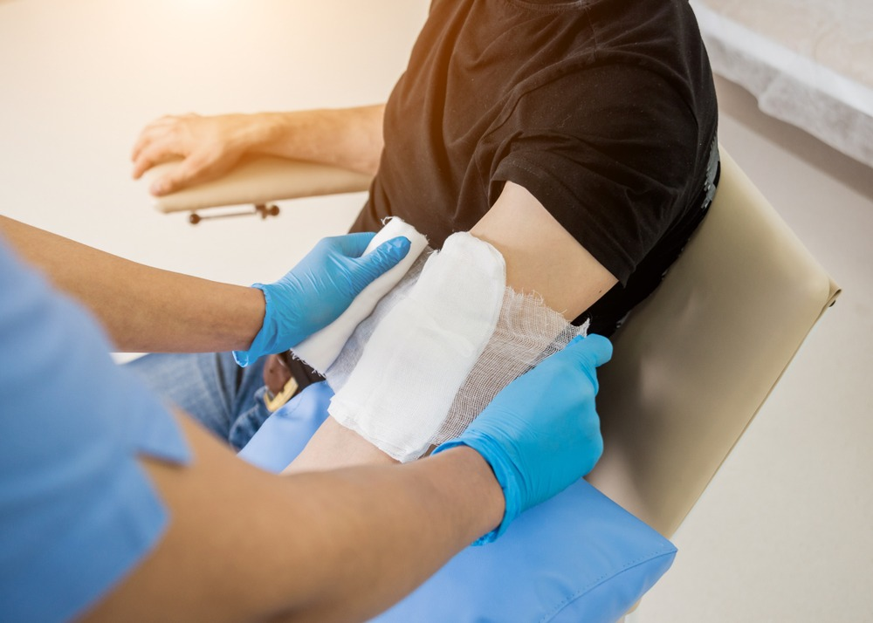
University of Basrah
College of Nursing
Fundamentals of Nursing Department
First Stage
Lecture 7: (Practice)
Dressing
University of Basrah –College of Nursing – Fundamentals of Nursing Department

Slide 2
Introduction
Skin acts as a barrier to protect the body from the potentially harmful external environment (microorganisms that cause infection.
When the skin integrity is broken, the body internal environment is open to.
Any abnormal opening in the skin is a wound.

Slide 4
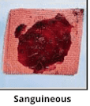
Types of wound exudate
1-serous:
clear, watery plasma
2-sanguineous:
Fresh bleeding

Slide 5
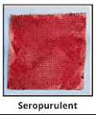
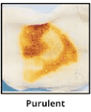
Types of wound exudate
3-serosanguineous:
pale, more watery drainage.
4-purulent:
Thick, yellow, green, or brown.

Slide 6
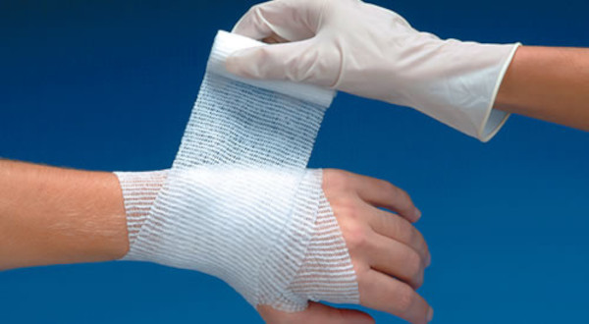
Dressing
Is a synthetic permeable membrane that acts as a temporary second skin.

Slide 9
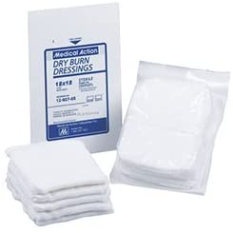
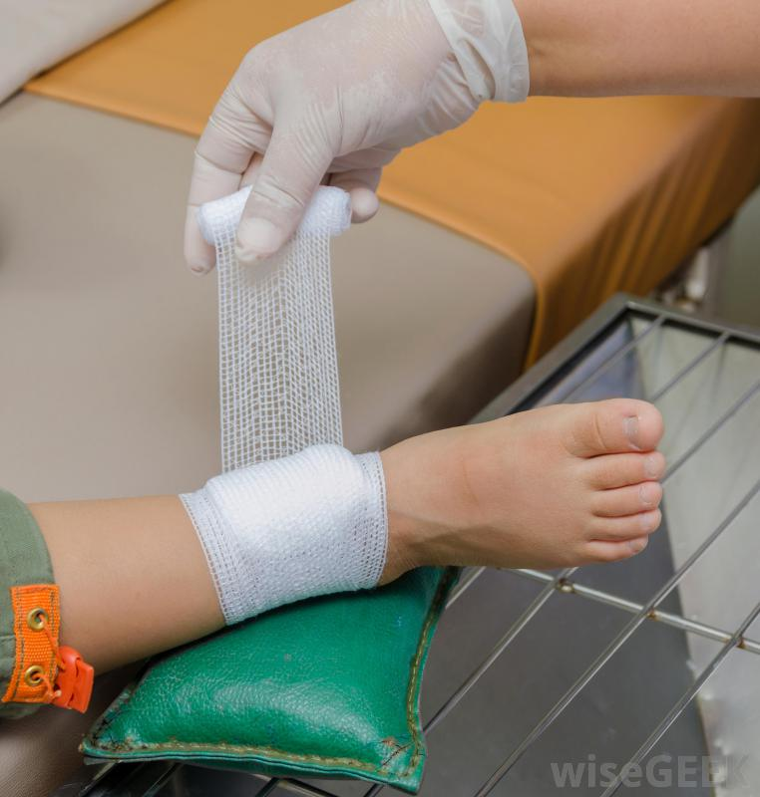
Dressing (dry or wet-to-dry)
Purpose of applying dry dressing??
protects the wound from injury.
Prevents introduction of bacteria.
Reduces discomfort
Speeds healing.

Slide 10
Indications of dry or wet-to-dry dressing
For abrasions and non-draining postoperative incisions.
not debride the wound and should not be selected for wounds requiring debridement.
Not appropriate for an open wound that is healing by secondary intention.

Slide 11
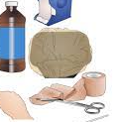
Wet-to-dry dressings
Gauze moistened with an appropriate solution.
Commonly used wetting agents include normal saline and lactated ringer solution, aid to remove dead tissue.
Then covered with a secondary
dry dressing.

Slide 12
to mechanically debride a wound.
the moistened contact layer of the dressing increases the absorptive ability of the dressing to exudate and wound debris.
Purpose of wet-to-dry dressings

Slide 13
Procedure of wet-to-dry dressings
1- Wash hand.
2- prepare equipment.
3- Put on on-sterile gloves.
4-pour saline into gauze and Squeeze the saline from the gauze pads until it is no longer dripping.
5- Place the gauze pads or packing tape in wound.
6- Carefully fill in the wound and any spaces under the skin.

Slide 14
Procedure of wet-to-dry dressings
7- Cover the wet gauze or packing tape with a large dry dressing pad.
8-Use tape or rolled gauze to hold this dressing in place.
9- Wash your hands again when you are finished.

Slide 15
Disadvantage's of
Wet-to-dry dressings
1- needs to be changed every 4 to 6 hours and removal of dressing.
2- A dressing that is too wet may cause tissue maceration and bacterial growth.
3- likely to cause pain to the client.

Slide 16
Risk factors for wound-healing problems
1- Aging
2-prematurity
3-Obesity
4-Diabetes
5-Compromised circulation.
6-Poor nutritional state
7-Immunosuppressive drug.

Slide 17
THANKS

